Slide 1
CM4 Only
New area on Moodle for Construction Management IT
Enrolment key is ‘547kvr957’

Slide 2

Basic Project Scheduling Time-Chainage Charts
Project Management
Year 4
Ref: Cooke B and Williams P (2009) Construction Planning, Programming & Control, Third Edition, Wiley-Blackwell Publishing, ISBN 978-1-4051-8380-2

Slide 3
Time-Chainage Charts
AKA
Time-Distance diagrams (or charts)
Time-Location diagrams (or charts)
Location-Time diagrams (or charts)
Etc.
Time-chainage diagrams are a combination of the bar-chart and line of balance schedules.

Slide 4
History
Relatively new tool for scheduling projects
TC charts have gained wide acceptance in:
Motorway construction
Railway construction
Pipeline work
Tunnel construction
Bridges
The technique was used for tunnelling and fixed equipment installation on the channel tunnel project

Slide 5
Time-chainage diagrams are only appropriate for certain types of project, and therefore is not as widely used as bar charts (Gantt) or network techniques.
It is not available on MS Project…
Time chainage has distinct attributes and advantages on projects where it is important to depict
The order of activities or operations
The location of activities
How activites must progress in relation to direction and distance
Time, Key dates, holidays, etc.

Slide 6
3500
3000
Retaining
Wall
2500
2000
Chainage (Distance)
Set Up Site
Fencing
Holidays
Road Surfacing
Drainage
Footbridge
1500
1000
Bulk Earthworks
500
0
5
10
15
20
25
30
35
Weeks

Slide 7
Example
Consider a project to improve a 3.5km stretch of motorway. The activities are as follows
Fencing
Drainage
Bulk Earthworks -
Footbridge
Retaining wall
Road surfacing
Ref: Cooke B and Williams P (2009) Construction Planning, Programming & Control, Third Edition, Wiley-Blackwell Publishing, ISBN 978-1-4051-8380-2

Slide 8
Further information
Set-up Site
starts at time 0,
duration 6 weeks
Fencing
Starts week 7
Duration 9 weeks, therefore finish week 15
Full 3.5 km to be fenced
Holiday Period
Starts week 26 for 1 week
Ref: Cooke B and Williams P (2009) Construction Planning, Programming & Control, Third Edition, Wiley-Blackwell Publishing, ISBN 978-1-4051-8380-2

Slide 9
3500
3000
2500
2000
Chainage (Distance)
Set Up Site
Fencing
Holidays
1500
1000
500
0
5
10
15
20
25
30
35
Weeks

Slide 10
Further information
Drainage
starts week 12
duration 4 weeks, therefore finish week 16
Drainage required for full 3.5km
Bulk Earthworks
Starts week 15
Duration 5 weeks, therefore finish week 20
Required from 500m to 1000m
Footbridge
Starts week 16 for 9 weeks, therefore finish week 25
Required 1500m
Ref: Cooke B and Williams P (2009) Construction Planning, Programming & Control, Third Edition, Wiley-Blackwell Publishing, ISBN 978-1-4051-8380-2

Slide 11
3500
3000
2500
2000
Chainage (Distance)
Set Up Site
Fencing
Holidays
Drainage
Footbridge
1500
1000
Bulk Earthworks
500
0
5
10
15
20
25
30
35
Weeks

Slide 12
Further information
Retaining Wall
starts week 16
duration 8 weeks, therefore finish week 24
Required from 2500m to 2900m
Progresses at a rate of 50m per week
Road Surfacing
Starts week 30
Duration 5 weeks, therefore finish week 35
Entire 3.5km to be surfaced
Ref: Cooke B and Williams P (2009) Construction Planning, Programming & Control, Third Edition, Wiley-Blackwell Publishing, ISBN 978-1-4051-8380-2

Slide 13
3500
3000
Retaining
Wall
2500
2000
Chainage (Distance)
Set Up Site
Fencing
Holidays
Road Surfacing
Drainage
Footbridge
1500
1000
Bulk Earthworks
500
0
5
10
15
20
25
30
35
Weeks

Slide 14
Tips for Constructing Time Chainage Diagrams
Examine Layout Drawings etc and determine locations of important features
Draw a sketch of the diagram, and include holidays etc.
List main activities in approximate sequence. Include site setup and clearance
For static activities (footbridge), ‘block out’ the location, distance, and the correct duration
Beware of changes in axis: time chainage is relatively new and conventions have yet to take hold

Slide 15
3500
3000
Retaining
Wall
2500
2000
Chainage (Distance)
Set Up Site
Fencing
Holidays
Road Surfacing
Drainage
Footbridge
1500
1000
Bulk Earthworks
500
0
5
10
15
20
25
30
35
Weeks

Slide 16
3500
3000
Retaining
Wall
2500
2000
Chainage (Distance)
Set Up Site
Fencing
Holidays
Road Surfacing
Drainage
Footbridge
1500
1000
Bulk Earthworks
500
0
5
10
15
20
25
30
35
Weeks

Slide 17
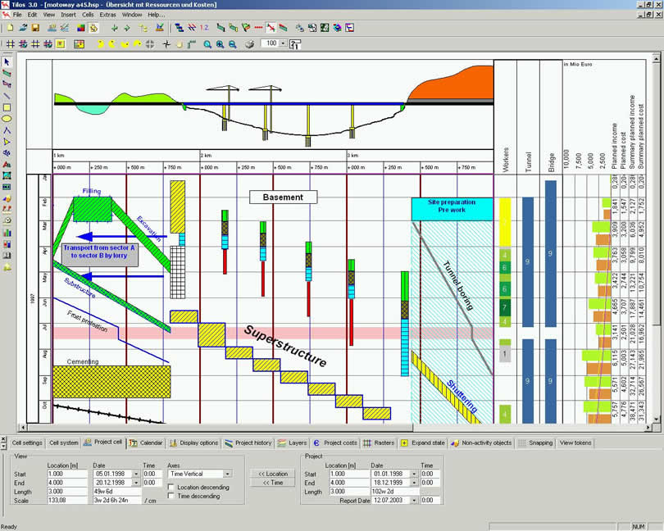
TILOS
Commercial Software Package for Time Chainage Diagrams
Free demo version available on website
http://www.astadev.com/software/tilos/index.asp
Installed in 4C02 and 4C03

Slide 19
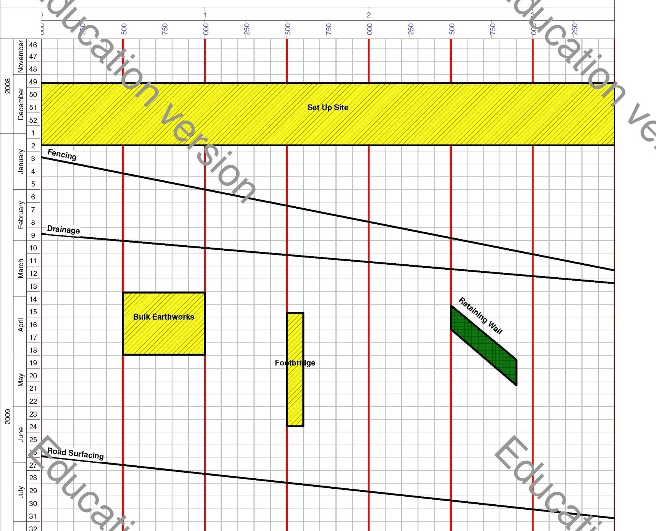
TILOS Example

Slide 20
Further Reading
Cooke B. and Williams P. (2009) Construction Planning, Programming & Control, Third Edition, Wiley-Blackwell Publishing, Chapter 9
ISBN 978-1-4051-8380-2

